Slide 1
Year 1 Phonics Screening Check
Information Evening

Slide 2
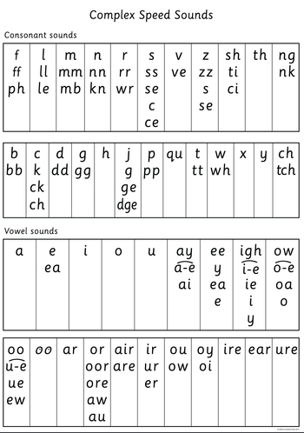
What is phonics?
Children begin learning sounds in Reception and continue this in Year 1. For those children who need it, they will continue to learn phonics in Year 2 as well. Over the course of their phonics sessions, the children learn 44 different sounds and how to blend them for reading and segment them for spelling. During Year 1 we learn alternative spellings of sounds the children already know e.g. ee, ea, e-e, y.
The books that the children take home to read directly match with the sounds the children know and can apply to words. These books support the children to develop fluency in their reading while they continue to learn new sounds through phonics teaching.

Slide 3
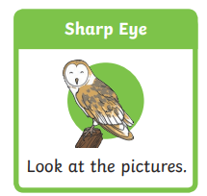
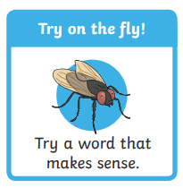
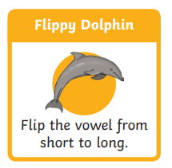
What is the phonic screening check?
Throughout the country, children in Year 1 will be taking part in a phonics screening check at the beginning of June. In addition, children in Year 2 who did not achieve the required result previously will also undertake the check.
The check is designed to assess whether children have developed decoding and blending skills to a sufficient standard. Importantly, the children will not be aware that they are completing this check. They are very used to completing short tasks with a teacher or teaching assistant so this will not be unusual for them. We would appreciate your support in keeping this very low key for the children.
It is worth noting that alongside phonics, we teach the children a number of other skills to support their reading e.g. sharp eyes, try on the fly, flippy dolphin. You will have seen stickers in their purple reading record books to indicate when we have taught these skills. Once a new skill has been taught, we continue to support children to use it throughout the year.

Slide 4
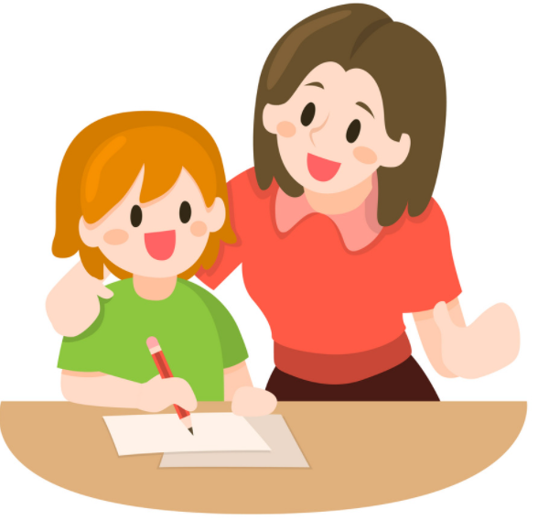
What happens during the phonics screening check?
Each child will work individually with a teacher to complete the check. They will be asked to read 40 words aloud. Each child will work at their own pace but for most of the children this will take around 10 minutes to complete.
The list of words comprises 20 real words and 20 pseudo words (nonsense words).
There are some practice words at the beginning of the check to ensure your child understands the activity.

Slide 5
Pseudo words
Your child will know they are looking at a pseudo word as it will have a picture of an alien next to it. This is to ensure they do not try to turn it into a real word when they read it.
Pseudo words are included because they are new to all pupils so they do not favour children with a good vocabulary knowledge or visual memory of words. The children must use their blending skills to read them.
The children are used to reading these ‘alien’ words during their phonic sessions so this will not be new to them.

Slide 6
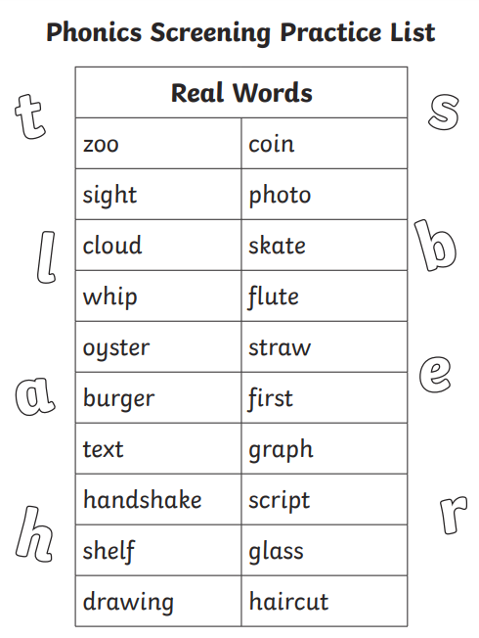
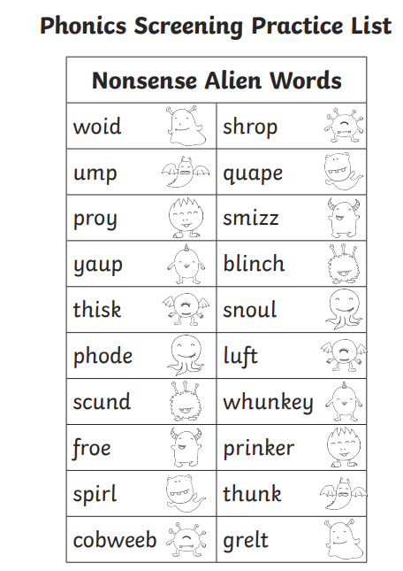
Here are some examples of the kind of words your child might read.

Slide 7
To help the children to prepare for this check we always ask the children to:
Identify the special friends (two or more letters making one sound)
Fred talk (say each sound from left to right)
Read the word (blend the sounds together)
During the check the children will be asked to draw the sound buttons under each word to ensure they are using this process to read each word.

Slide 8
Reporting your child’s results
The check is not about passing or failing but about making sure appropriate progress is being made. Children progress at different speeds so not reaching the threshold score does not necessarily mean there is a serious problem.
Your child’s results will be reported to you by the end of the summer term. In previous years the threshold mark has been 32 but we will not be told what the threshold mark is until after all the checks have been completed.
Any child who does not meet the required standard will continue with phonics sessions in Year 2 and will complete the check again the following summer.

Slide 9
How can I help my child at home?
Read as much as possible with and to your child.
Encourage and praise their attempts.
Practice the speed sounds at the front of their reading book before you read.
If your child is struggling to decode a word, encourage them to identify the special friends, Fred talk then read the word.
Discuss the meaning of words if your child does not know what they have read.

