Slide 1
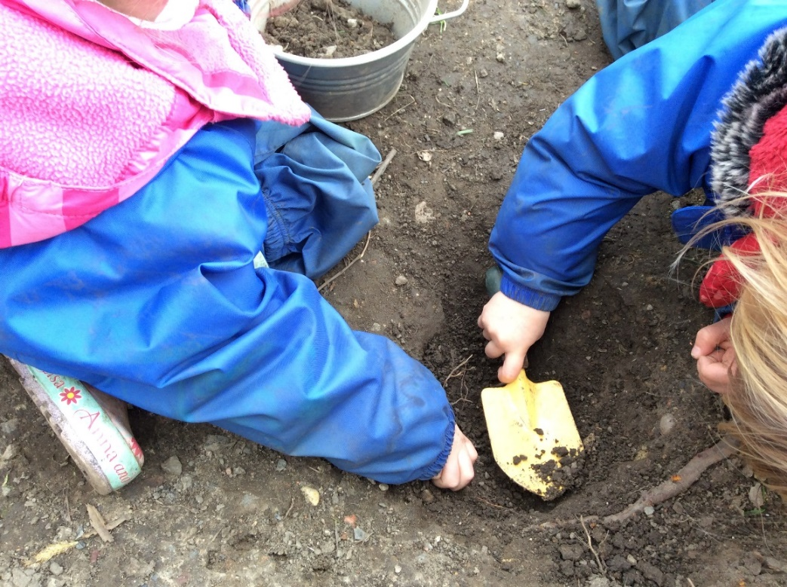
Welcome to Southridge Nursery
2021 - 2022

Slide 2
Meet the Team

Slide 4
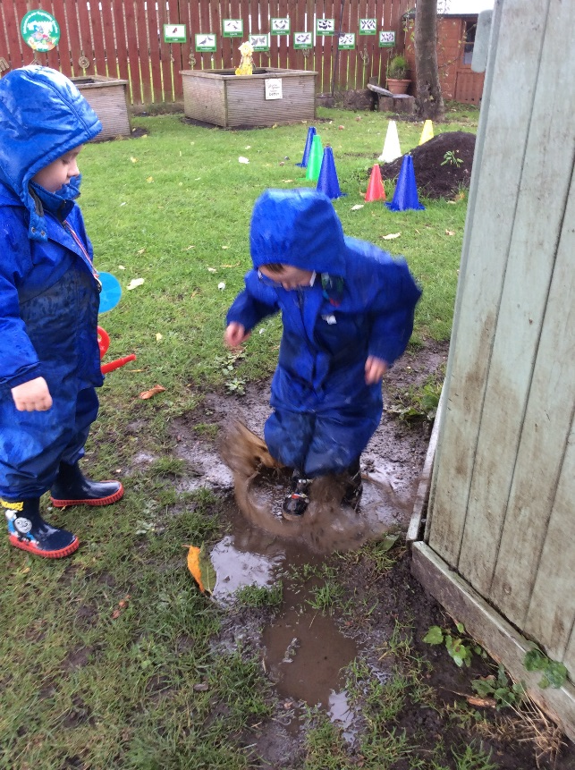
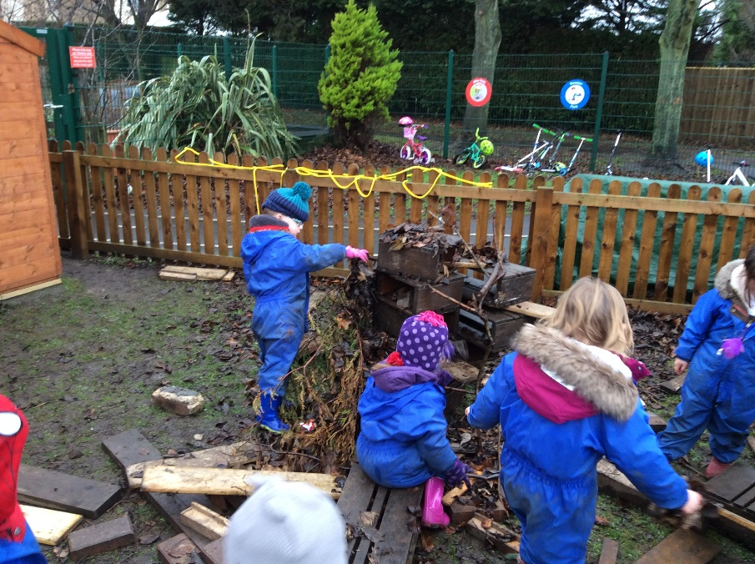
Outside Clothing
In Nursery we go outside whatever the weather so please ensure your child has the appropriate clothes and accessories. We ask you to provide a pair of wellies and a waterproof suit for children to keep at Nursery. Please don’t send them in their best coat – mud gets everywhere! Shoes should be easy for the children to manage themselves – velcro is best, laces and buckles can be more difficult and prevent the children from being independent.
Challenge Monday
Once a week the children take part in forest school style activities. This takes the form of challenges which encourage cooperation, team building, problem solving and exploring nature. We are currently developing a dedicated forest school area at the back of the school field.

Slide 5
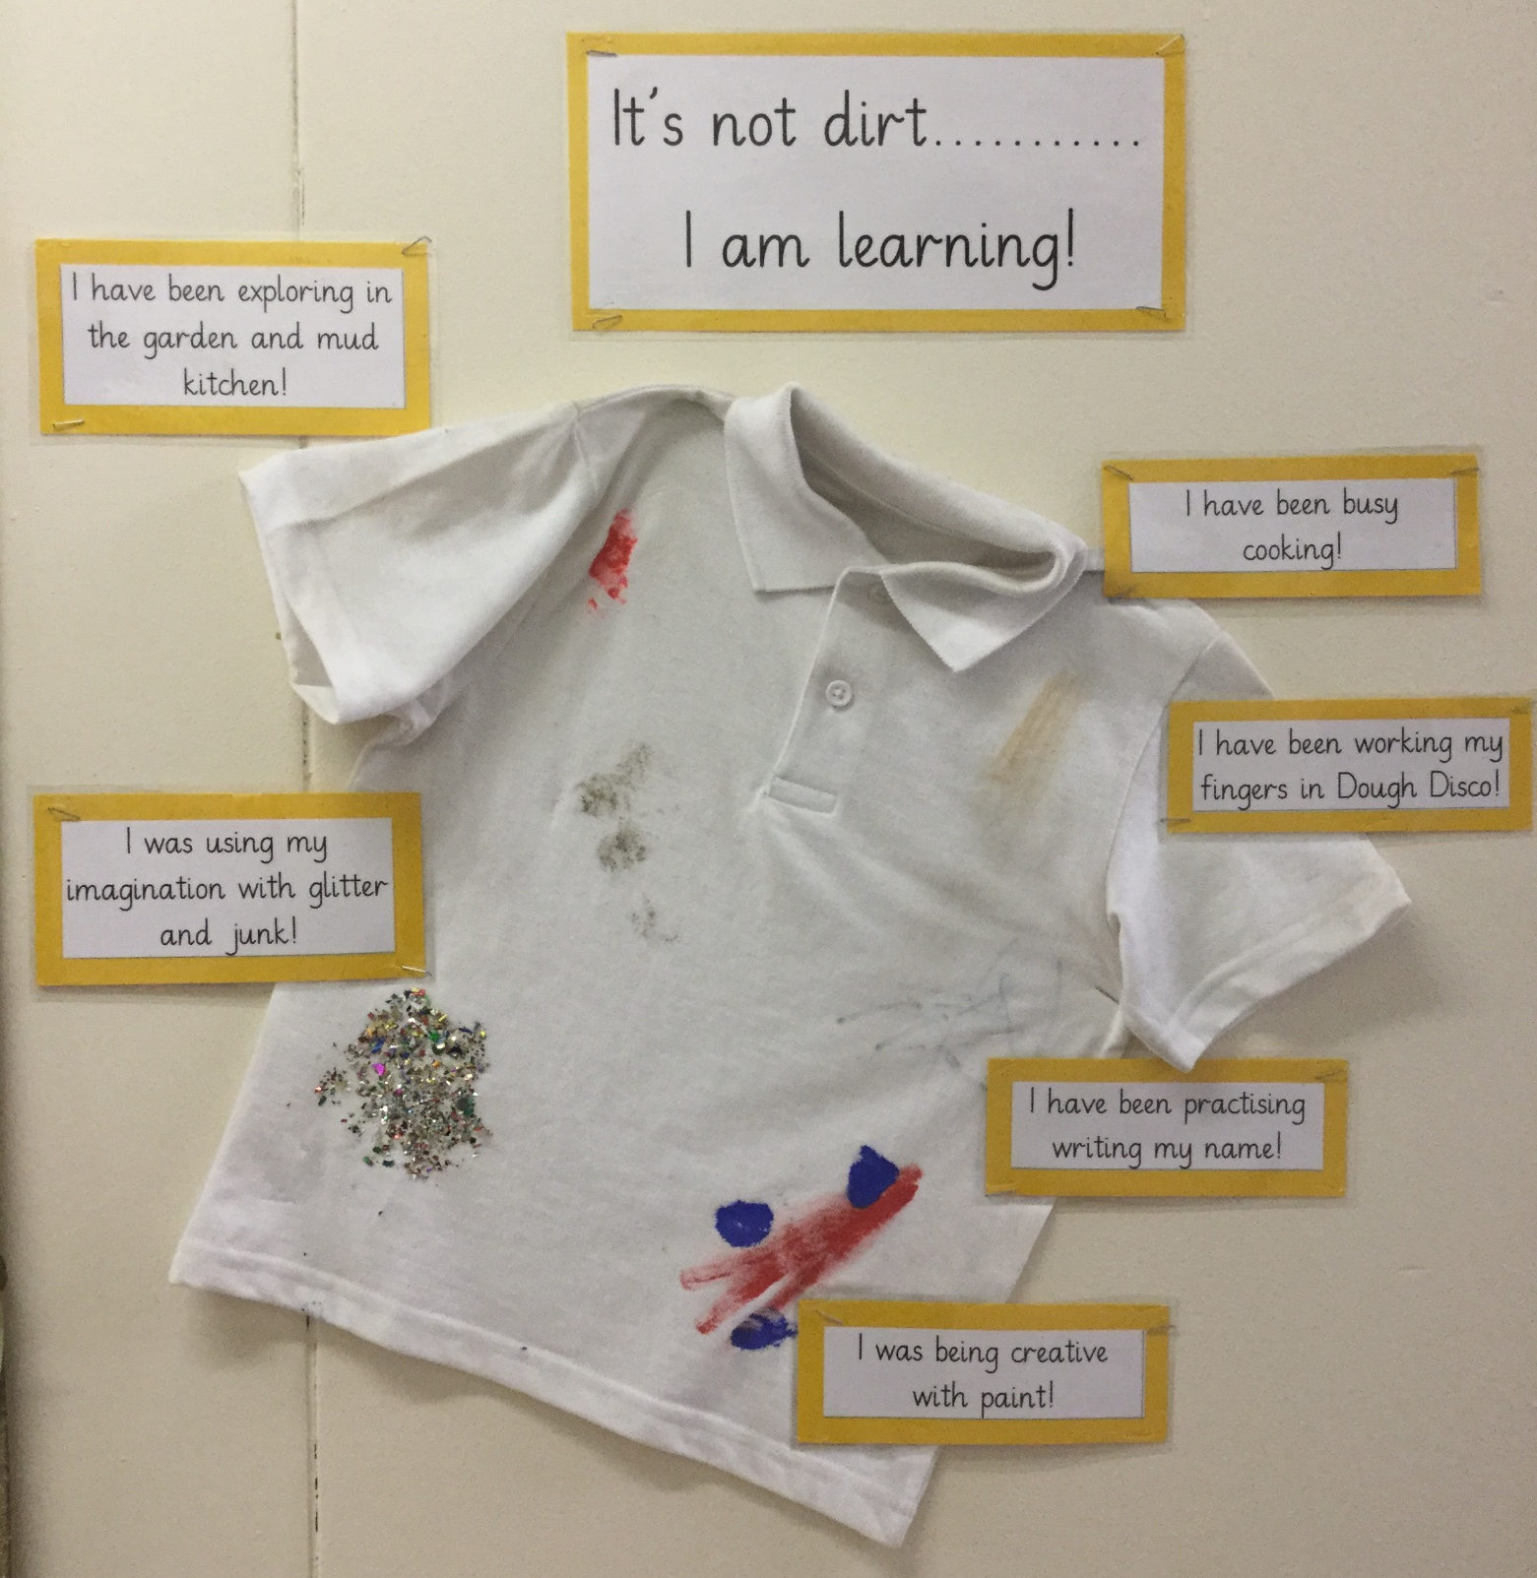
Think of your child’s uniform as overalls for learning.
We will be getting very messy whilst: cooking, exploring, investigating, being creative and much more. So do expect your child’s uniform to get dirty!
Please don’t buy expensive polo shirts. We recommend buying a pack of inexpensive white polo t-shirts such as the ones you might get in the supermarket.
Tracksuit bottoms and leggings are ideal for children to pull up and down by themselves when going to the toilet.

Slide 6
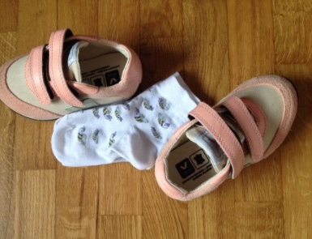
Taking off and putting on their shoes and socks.
Talk positively about Nursery.
Taking off and putting on their own coat.
Encourage them to ask lots of questions and listen to others.
Washing and drying their hands.
Help your child prepare for Nursery.
Wiping their own nose.
Going to the toilet independently. If you have any concerns about this please feel free to ring us for a chat or make a note of this in your child’s All About Me book.
Read lots of stories together and sing songs and rhymes.
Recognising the picture on their name card.

Slide 7
What is Important to us?
In Nursery we want to encourage children to:
be independent
develop a ‘can do’ attitude
show curiosity about the world
begin to solve problems
show a kind and caring attitude towards others
celebrate their own achievements as well as those of others
work as part of a team
In Nursery we want you as parents to:
Join us on your child’s learning journey – you play a huge part in it!
Feel you can always talk to us about any questions or concerns you have
Read our weekly newsletter which will be sent to you electronically

Slide 8
An Example of a Weekly Newsletter
Have a lovely weekend.
The Nursery Team

Slide 9
Please fill out any forms sent from our school office and return them ASAP along with your child’s All About Me booklet (before the end of the school term). This will help our staff get to know your child quickly.
If you have any questions please do not hesitate to contact us via the school office.
We are very much looking forward to meeting you all soon.
Miss Heads – Nursery Teacher
Mrs Mason – Nursery Teacher
Mrs Waller – Teaching Assistant/Teacher
Mrs Heason – Teaching Assistant

