Slide 1
Reading in Year 1

Slide 2
Reading in Year 1
Our aims for tonight are to explain:
How it is taught
How is it assessed
How you can support at home
Look at some of the materials we use
Answer any questions

Slide 3
In Southridge, we use Read Write Inc to teach phonics.
It is a proven synthetic phonics programme that ensures early success in reading.
Speed sounds are taught in daily phonics sessions.
Regular assessments ensure the books children are reading are well matched to their phonic knowledge.
We also use our assessments to group the children for phonic sessions so they are receiving targeted support for the phonic sounds that they need to learn.

Slide 4
Daily phonics - what does it look like?
Introduce new sound
Re-cap sounds previously learned and identify new sound
Apply new sound to reading green words
Apply new sound to reading alien words
We always identify the ‘special friends’, ‘Fred talk’, then read the word.
Speedy write - identify the sounds within a word and write it down
Speedy green words - speedily read words we have previously learned (‘Fred in your head’)
Red words (common exception words)

Slide 6
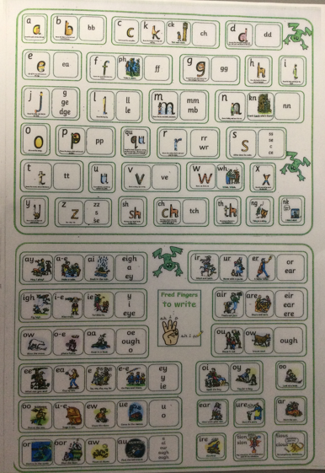

Slide 7
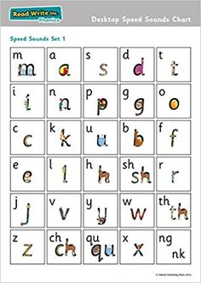
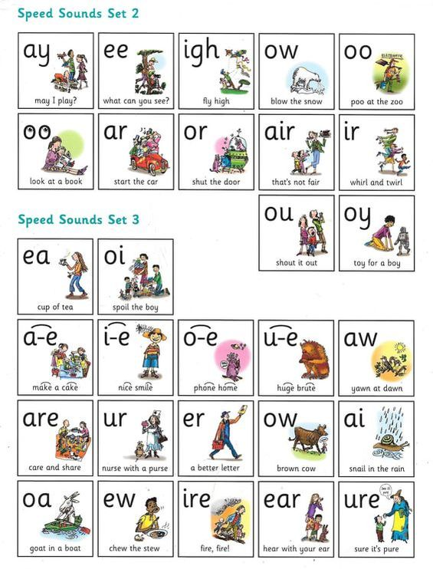
Set 1 Sounds Set 2 and 3 Sounds

Slide 8
How and when do we assess what the children know?
Children are assessed every 6-8 weeks on a one-to-one basis with a member of our team. We do not change reading levels in between assessment points.
They read the sounds they know.
They read real words and alien words by sounding them out loud.
They will also be asked to read a set of real words quickly. We call this Speedy Reading.

Slide 9
My child can read their book quite easily - why?
Children need to know all the sounds and be able to apply them for the level of book they are reading.
The book should not be a challenge for them to read.
The scheme is designed so that they will not meet any sounds they do not know confidently.
All new sounds are taught during their phonics sessions.

Slide 10
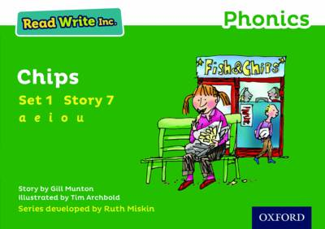
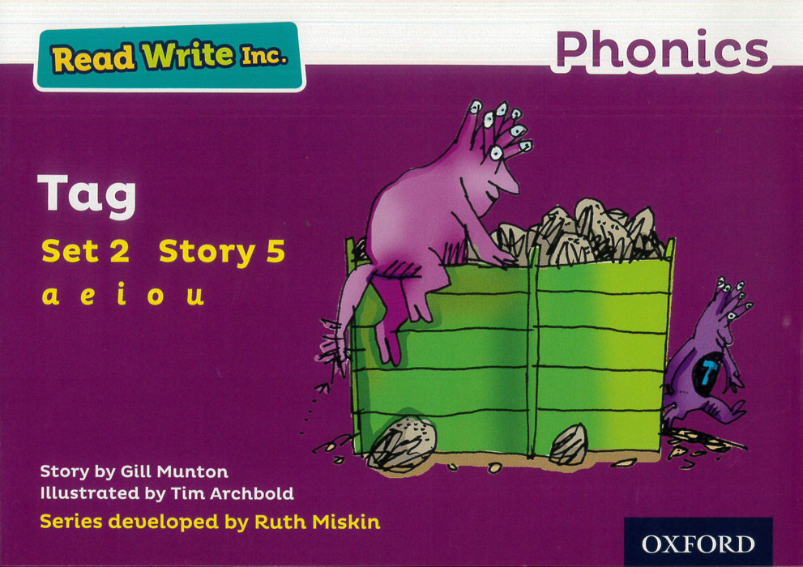
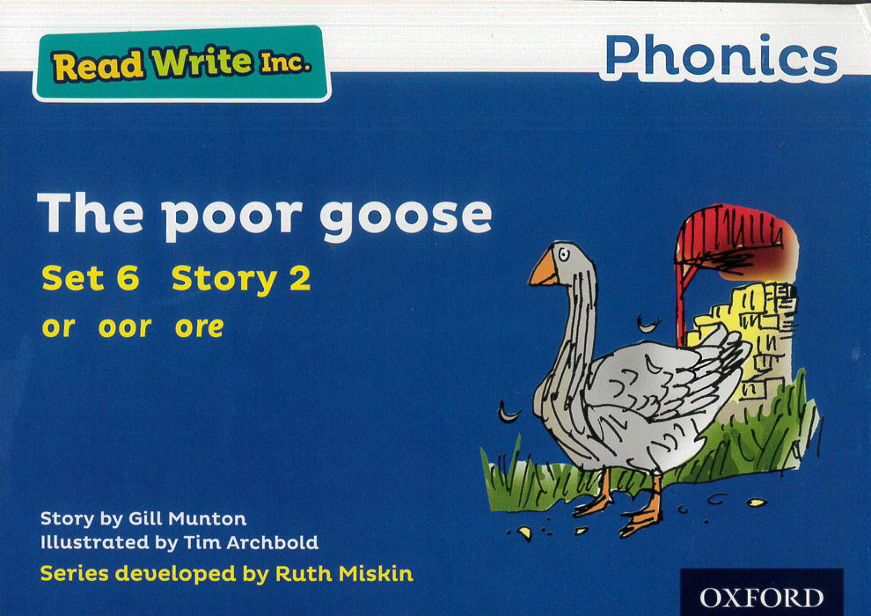
Children should be able to read their book confidently, independently, accurately, with pace and have a good understanding.
It’s all about success!

Slide 11
Reading Group Session
Children currently reading blending books, red or green books will read 3 times in school before they bring it home. This is to ensure they have had lots of opportunities to practise the words in isolation as well as in the story so they feel more confident when they read at home.
Children reading purple and above will will read their book once in school then bring it home.
The children always begin with their speed sounds. They read these with a partner, taking turns to point to the sounds in a random order with both partners reading the sound.
They then go through the green story words and red words and finally the speedy green words.

Slide 12
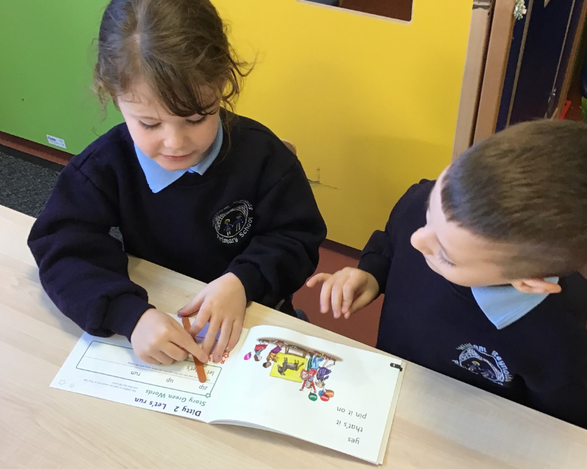
The children take turns with their partner to read a sentence or page each, helping each other if they get stuck.
During this time, the teacher will work with each child individually to listen to and support their reading.
There are opportunities to talk about the story, use new reading strategies and discuss features of the text as a group.
Children reading purple books and above will be encouraged to use ‘Fred in your head’ while reading as much as possible to help increase their pace and fluency.

Slide 13
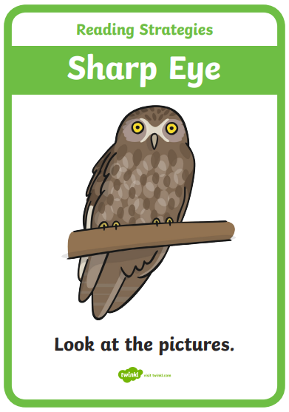
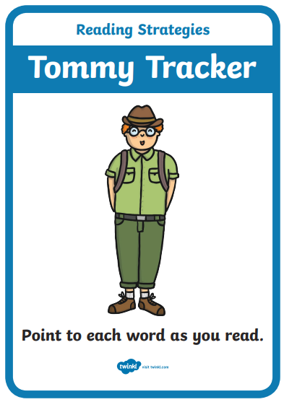
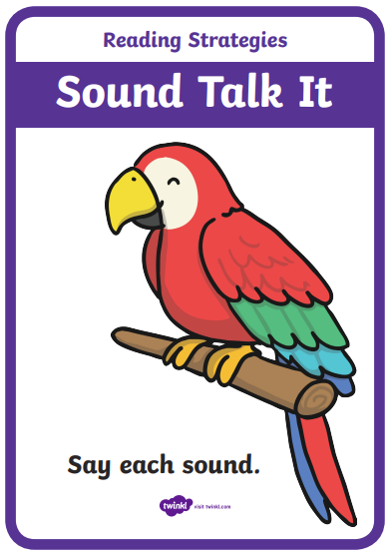
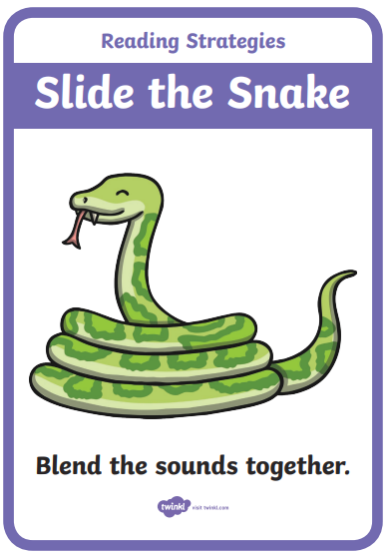
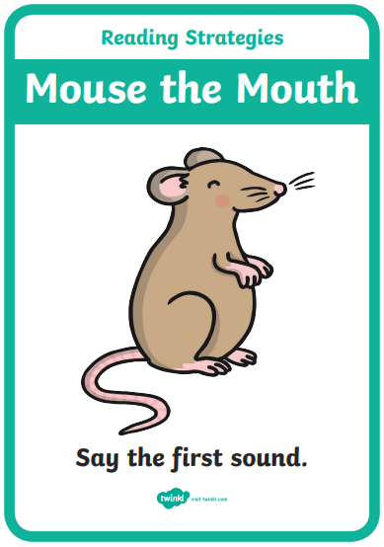
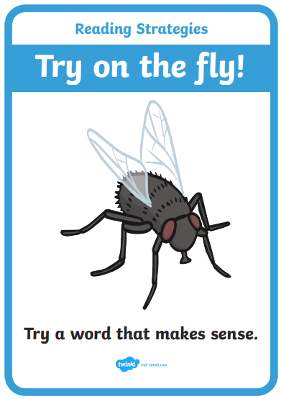
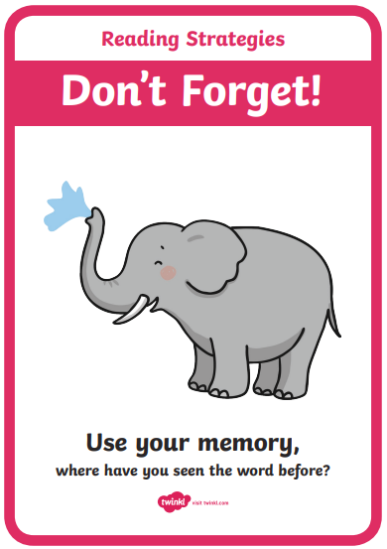
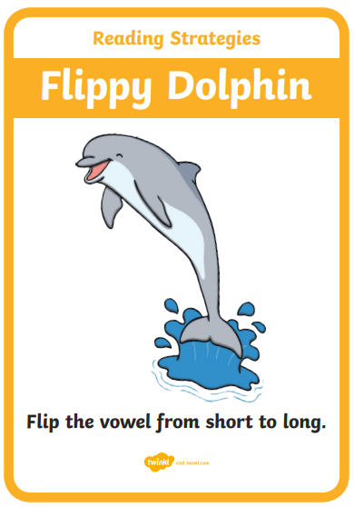
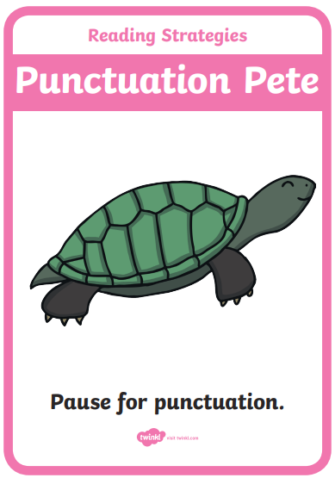
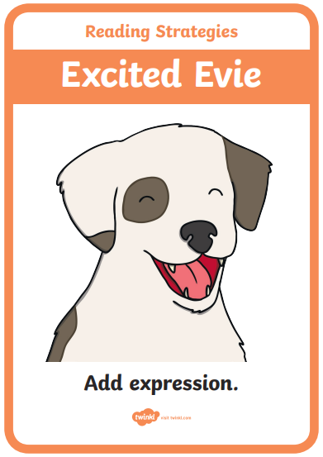
Reading Strategies

Slide 14
How can you help your child at home?
Reading little and often is key.
Always start with speed sounds and green/red words. Being able to read the words confidently will ensure they are able to read the story with more fluency.
You can find the ‘speedy green’ words at the back of the book.
Ideally we would aim for 3 readings of each book in a week - once for decoding, once for fluency and understanding and once with a reader’s voice.
If your child is finding it difficult, take turns reading as we would in school. It is important for them to hear it being read to them so that they know how it should sound.
Read regularly to your child. This helps to build their vocabulary, allows them to hear how it should sound and develops their comprehension.

Slide 15
How can you help your child at home?
If your child is reading confidently you could supplement their reading with other books from home where this is appropriate. This can also be recorded in their reading diary.
Please also continue to read their school books to ensure they are reading books at the appropriate level that will build fluency.
Re-reading familiar books is especially important when developing these skills.
Please circle the day in their reading diary each time they have read. You can use this to let us know about any difficulties or successes too.

Slide 16
